Slide 1


Stellar ReEntry Nurse

Slide 2


MY STORY: Shruti Sachar
I am not working in healthcare right now. I got my B.S.N. in 2006 and got my R.N. license in 2007. I previously worked in a hospital but I haven’t worked bedside since 2010.
I’m ready to return to nursing but I don’t know where to start.
Job postings require “recent experience”. I can’t get hired.
I need to show that I am competent with clinical skills so the hospitals or agencies will hire me.
2006
2021

Slide 3
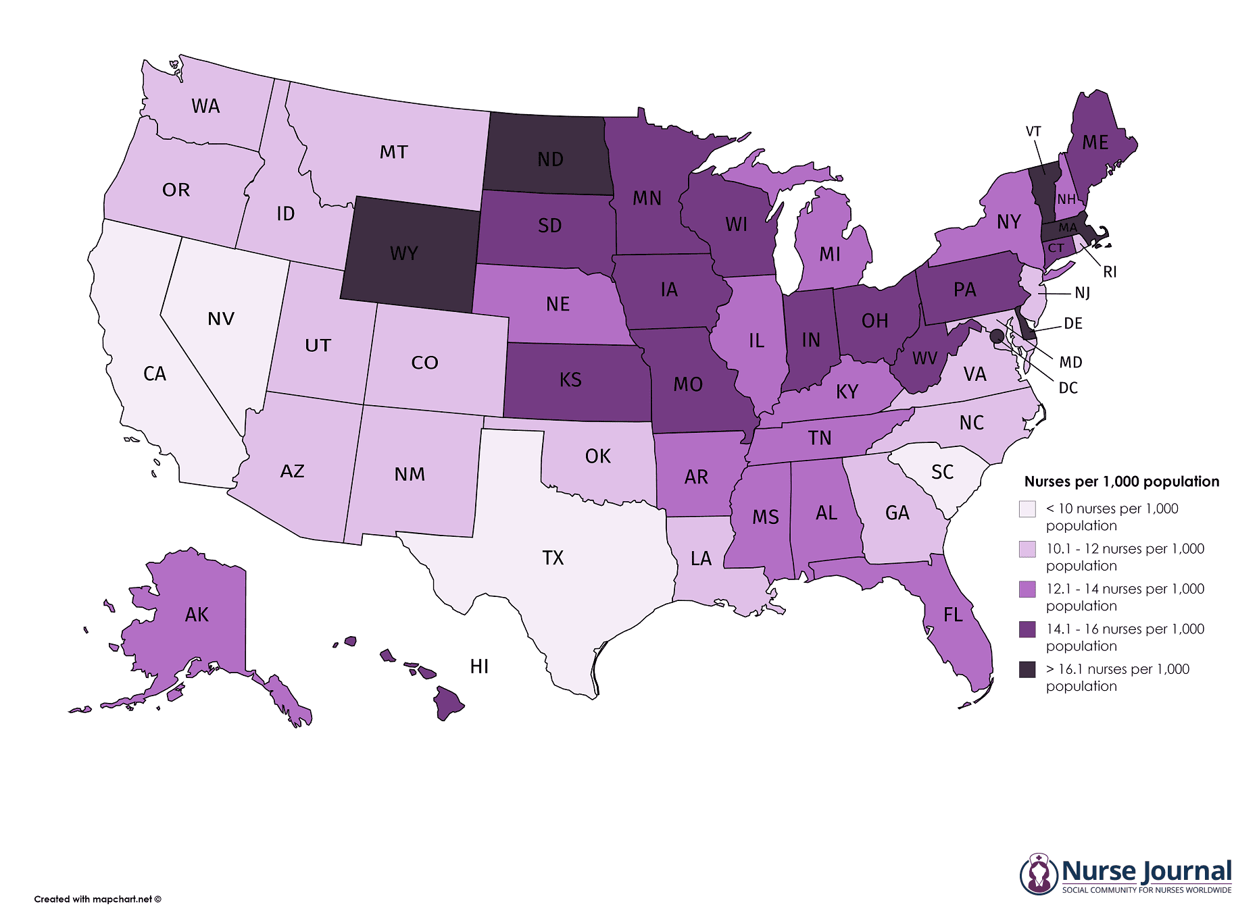
PROBLEM: No near-term solution to nursing shortage today!
In the next five years, 900,000 nurses are projected to permanently leave the profession
Employers will need to hire 1.1 million nurses by 2026
Nursing Schools are struggling to expand capacity to meet the rising demand.
https://www.thisweekhealth.com/mercer-report-healthcare-labor-shortage-will-continue-to-grow/

Slide 4



SOLUTION: 570,000 Re-entry Nurses
570K
15.5%
Nurses who are not working at the bedside are the solution to filling the nursing shortage in the interim while the nursing schools ramp up and graduate more nurses.
Licensed nurses not working at the bedside could potentially start working today if they had the training to do so.
3.4 Mil
84.5%
https://www.usa.edu/blog/nursing-shortage/

Slide 5


SOLUTION: Steller Nurse Re-Entry Program
Re-Entry Nurse Training Program
6 week 36 hour long, 36 module based
Competency and clinical based education
Taught by veteran nurses with 20+ years of bedside experience
Nurses will leave with a certificate and digital badge
Veteran Nurses provide educational content
Remote flexible schedule

Slide 6




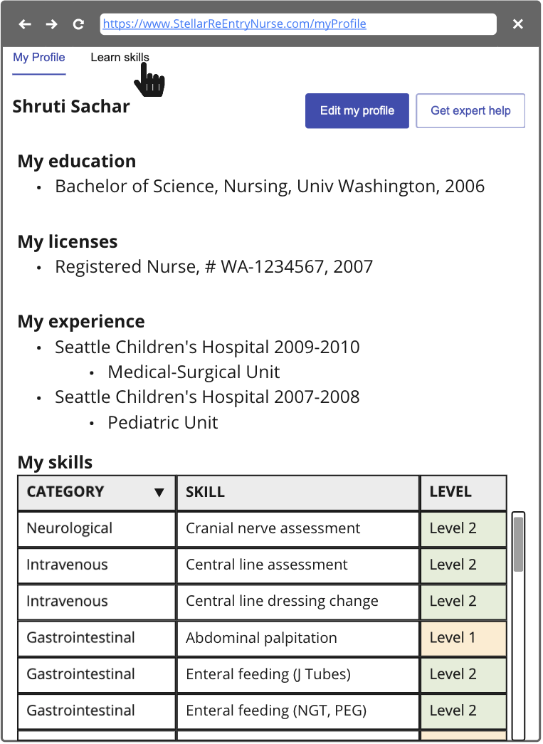
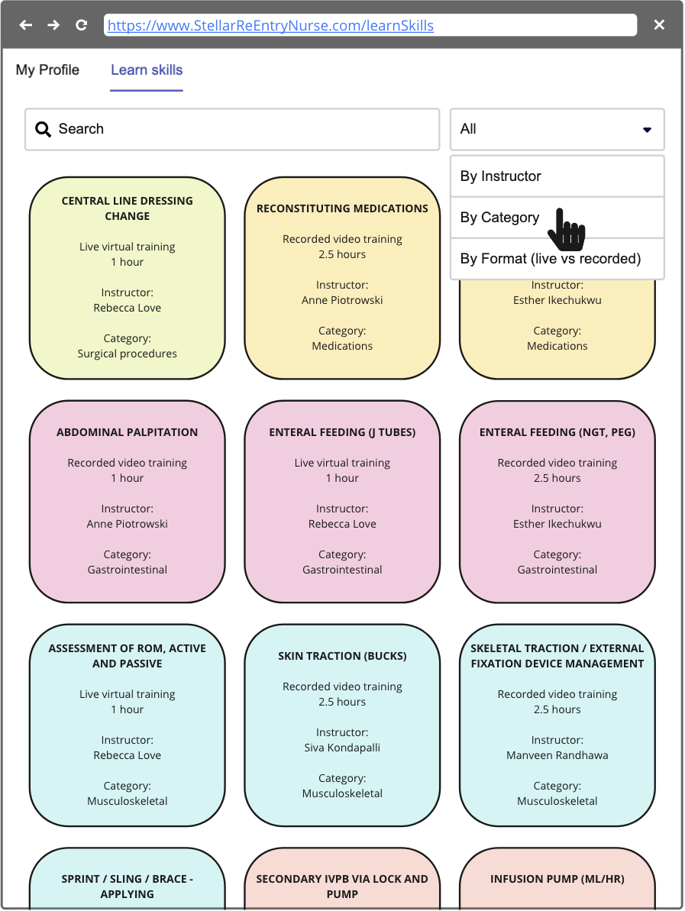
PRODUCT SOLUTION: App-enabled Skills Retraining
App-enabled retraining
Competency-based upskilling
Easily accessed
Stellar
ReEntry
Nurse

Slide 7
Stellar ReEntry Nurse Versus Competitors
Stellar ReEntry Nurse vs Competitors
Benefits | Stellar ReEntry Nurse | Indeed | LinkedIn | You Tube | Coursera
Skills based resume | X
Theoretical Knowledge | X |  |  | X | X
Clinical Skills | X |  |  | X
Evaluations and Tests | X

Slide 8

Business Model
6 week Re-Entry Nurse Training Program
$1500 (compare to industry typical cost $16K to recruit each nurse)
36 hour long
36 modules
CE content - reactivate license
2 Buyers
B2C - Nurses
B2B - Hospitals
Hire SMEs
ED nurse with 25 years of experience
67 year old nurse with 40 years ICU experience
Veteran Oncology nurse with 30 years of experience

Slide 9

Impact
Employers will need to hire 1.1 million nurses by 2026
We have 570k nurses who could potentially start working today
We believe through this program that we can eliminate 25% of shortage
This will buy time for nursing schools to ramp up and produce more nurses
Veteran Nurses
The immediate availability of nurses will improve patient care outcomes and save their lives

Slide 10
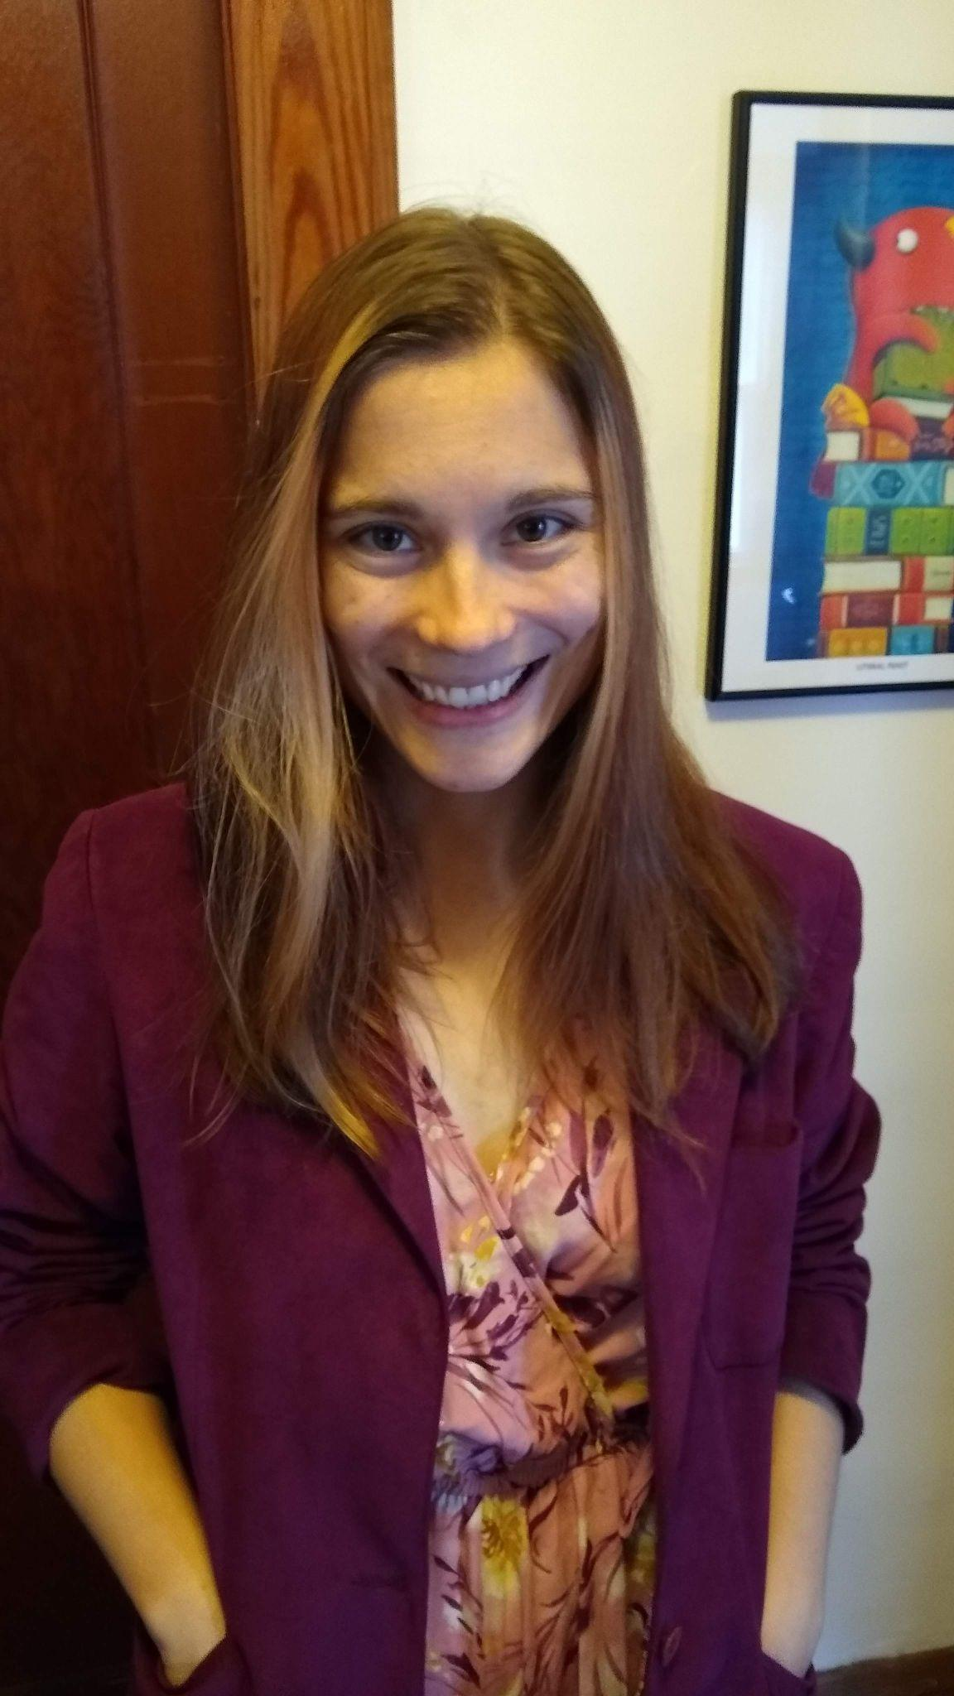



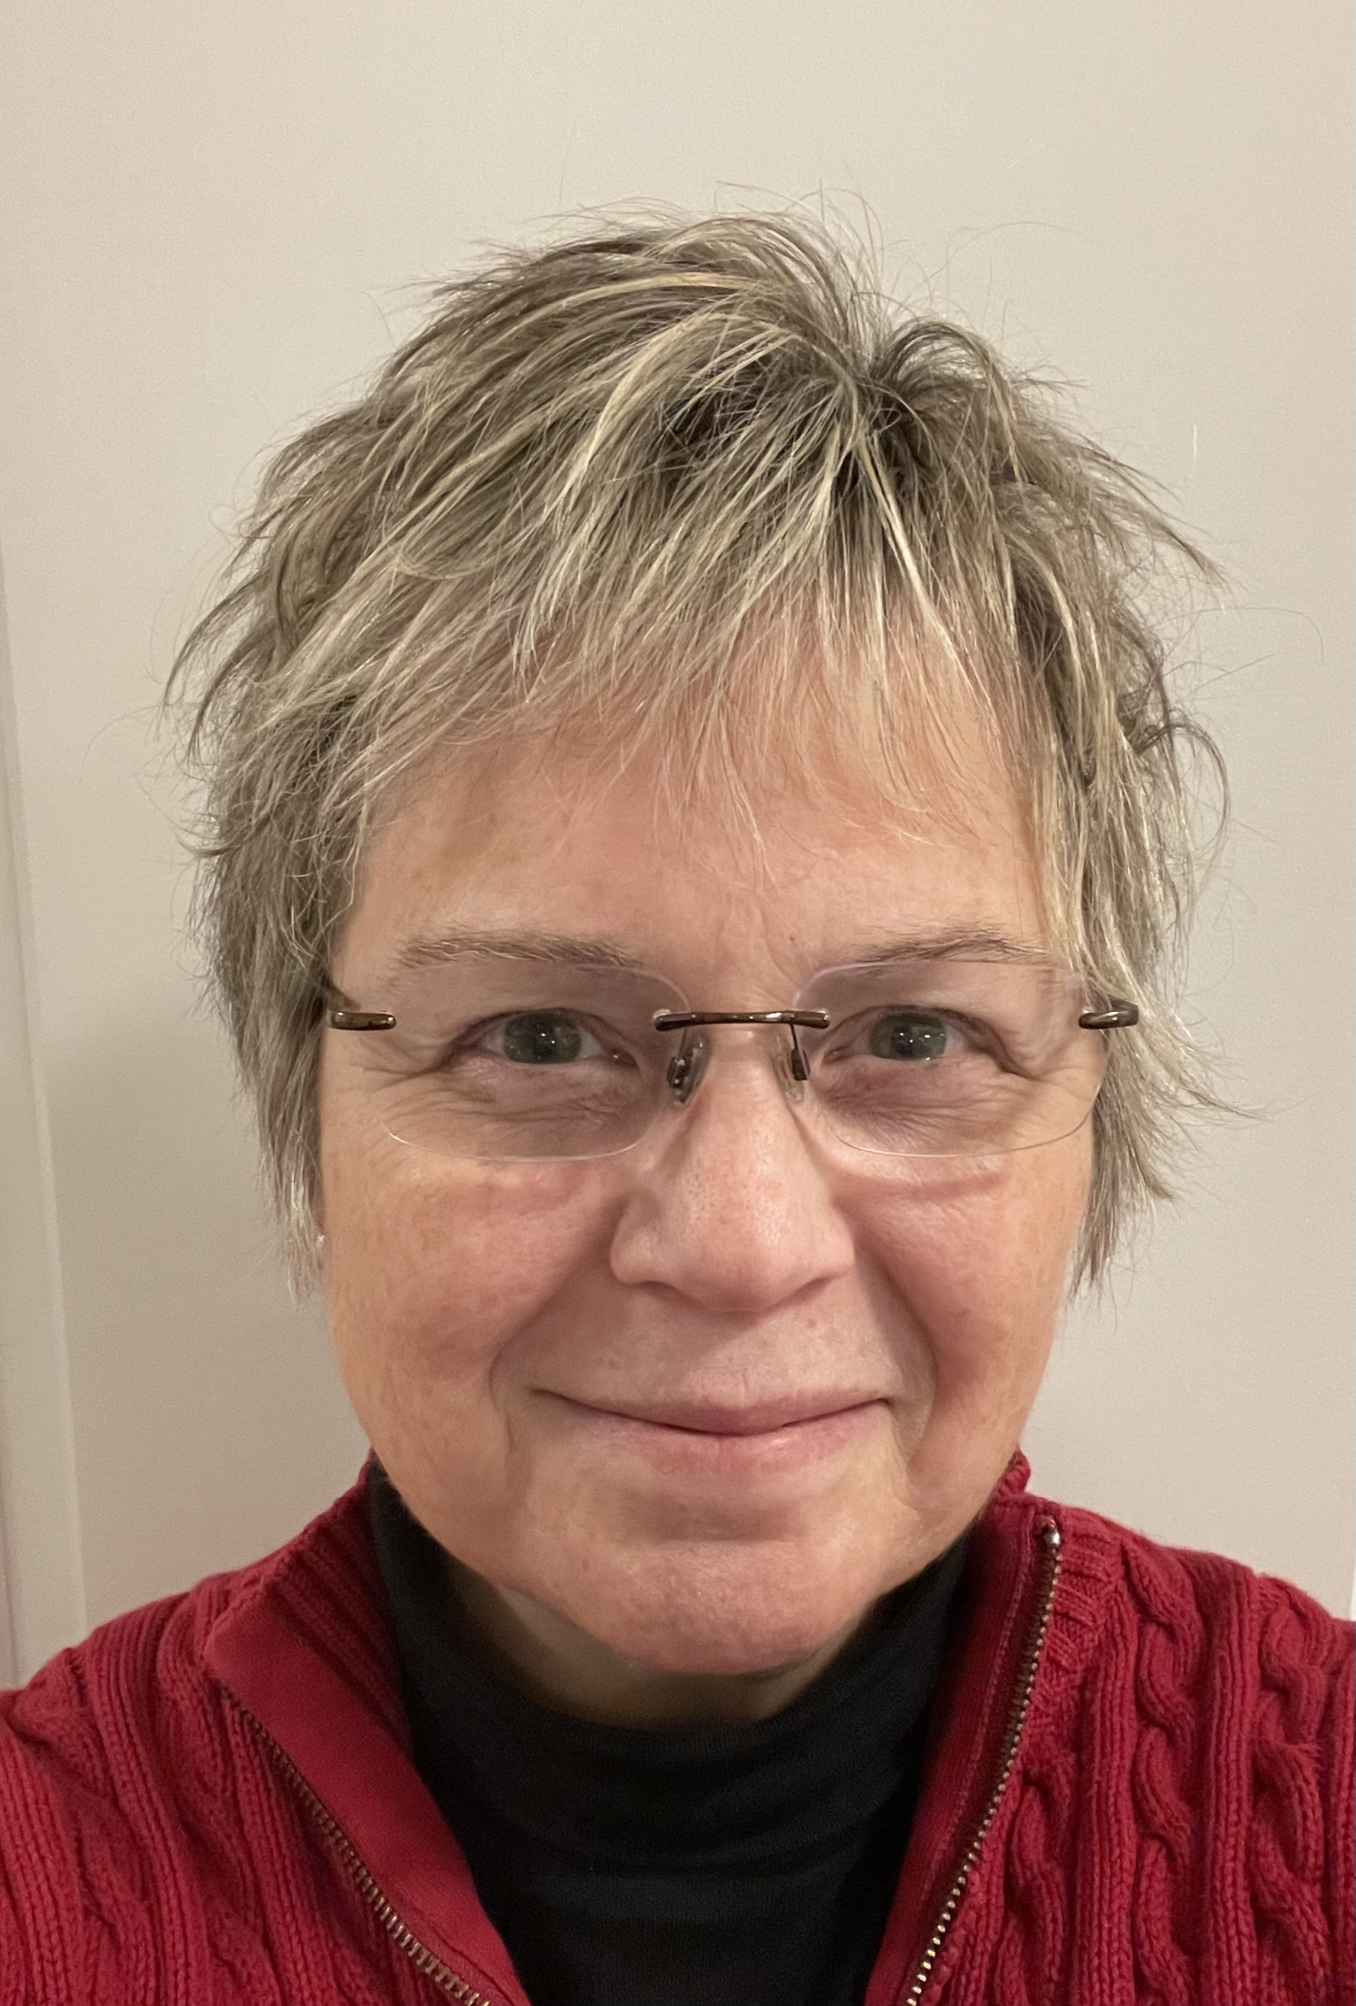
Team Stellar ReEntry Nurse
Shruti Sachar
RN/MSN
Anne Piotrowski
Software developer
Siva Kondapalli
Software developer
Esther Ikechukwu
RN/BSN
MS Health Informatics
Manveen Randhawa
Software developer
Kim Trumbull
User Experience

Slide 11

The End

